Slide 1
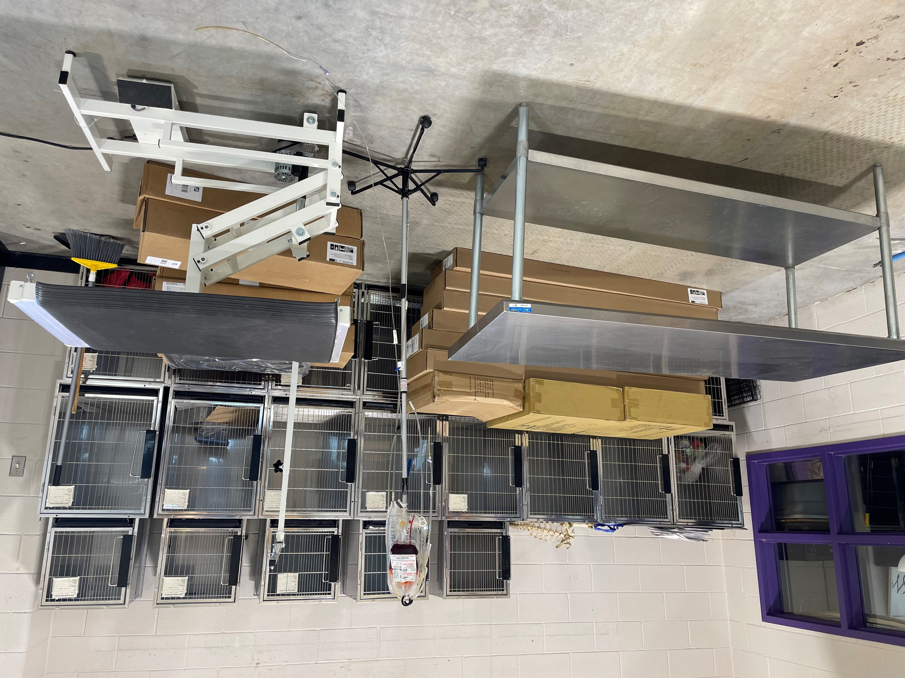
Animal Science
Statewide Program of Study
Agriculture, Food, and Natural Resources Career Cluster
The Agriculture, Food, and Natural Resources (AFNR) Career Cluster focuses on the essential elements of life food, water, land, and air. This career cluster includes a diverse spectrum of occupations, ranging from farmer, rancher, and veterinarian to geologist, land conservationist, and florist. It also includes non-traditional agricultural occupations like wind energy, solar energy, and oil and gas production.
The Animal Science program of study focuses on the science, research, and business of animals and other living organisms. It teaches CTE learners how to apply biology and life science to real-world life processes of animals and wildlife, either in laboratories or in the field, which could include a veterinary office, a farm or ranch, or any outdoor area harboring animal life. Students may also research and analyze the growth and destruction of species and research or diagnose diseases and injuries of animals.
Secondary Courses for High School Credit
1 Principles of Ag, Food, & Natural Res.
2 Livestock Production
3 Veterinary Medical Applications
4 Practicum in Ag, Food, & Natural Res.
OR
Advanced Animal Science
Work-Based Learning and
Expanded Learning Opportunities
Exploration Activities | Work-Based Learning Activities
Participate in Texas FFA | Volunteer at a local farm or with a veterinarian Participate in an FFA supervised agriculture experience
Industry-Based Certifications
Certified Veterinary Assistant, Level 1
Elanco Fundamentals of Animal Science Certification
Postsecondary Opportunities
Associates Degrees
Food Science and Technology
Veterinary Studies
Biotechnology Laboratory Technician
Biology Technician
Bachelor’s Degrees
Animal Sciences
Agriculture
Biology
Zoology/ Animal Biology
Master’s, Doctoral, and Professional Degrees
Genetics
Veterinary Medicine
Biological and Physical Sciences
Biological and Biomedical Sciences
SMHS Veterinary Clinic
Aligned Occupations
Occupations | Median Wage | Annual Openings | % Growth
Animal Breeders | $39,139 | 28 | 9%
Animal Scientists | $57,533 | 22 | 12%
Medical Scientists | $63,898 | 435 | 27%
Veterinarians | $93,496 | 294 | 24%
Zoologists and Wildlife Biologists | $67,309 | 45 | 32%
Successful completion of the Animal Science program of study will fulfill requirements of a Business and Industry endorsement or STEM endorsement if the math and science requirements are met. Revised – August 2022

Slide 2
Animal Science Course Information
COURSE NAME | SERVICE ID | PREREQUISITES | COREQUISITES
Principles of Agriculture, Food, and Natural Resources | 13000200 (1 credit) 6100 | None | None
Livestock Production | 13000300 (1 credit) 6111 | Principles of AFNR | None
Veterinary Medical Applications | 13000600 (1 credit) 6403 | Livestock Production | None
Practicum in Agriculture, Food, and Natural Resources | 13002500 (2 credits) 6404 | Veterinary Medical Applications | None
Advanced Animal Science | 13000700 (1 credit) 6109 | Biology and Chemistry or Integrated Physics and Chemistry (IPC); Algebra I and Geometry; and Veterinary Medical Applications | None
FOR ADDITIONAL INFORMATION ON THE AGRICULTURE, FOOD, & NATURAL RESOURCES CAREER CLUSTER,
PLEASE CONTACT: CJ Odam, SMCISD CTE Coordinator cj.odam@smcisd.net
San Marcos CISD does not discriminate on the basis of race, color, national origin, sex, disability or age in its programs or activities and provides equal access to the Boy Scouts and other designated youth groups. The following person has been designated to handle inquiries regarding the nondiscrimination policies: Stephanie Munoz ; 631 Mill St, San Marcos, TX 78666 ; 512-393-6700 ; stephanie.munoz@smcisd.net
Further nondiscrimination information can be found at smcisd.net/cte

